Slide 1
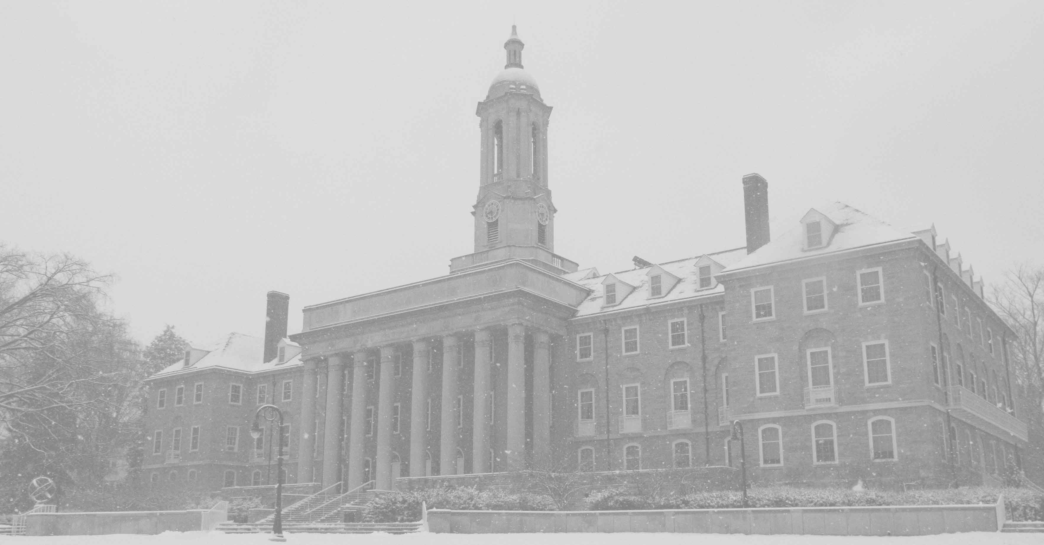
Spring 2022 Academic Schedulers Meeting
Tryphena Miska, Associate Registrar, Curriculum, Scheduling, & Academic Records
Cortney Gruneberg, Assistant Registrar, Curriculum and Scheduling
Office of the University Registrar
www.registrar.psu.edu

Slide 2
Agenda
ALC Classrooms
Requesting Room Characteristics
Timelines
Final Exams
Evening Exams
Course Catalog
Pay Detail/Workload
25Live Reserve vs. Reserve Available
Optimizer
Contacts
Office of the University Registrar
www.registrar.psu.edu

Slide 3
University Park
Flexible Learning Spaces
General Purpose Classrooms (GPC)
March 2022

Slide 4
Finding Flexible Spaces in 25 Live

Slide 5
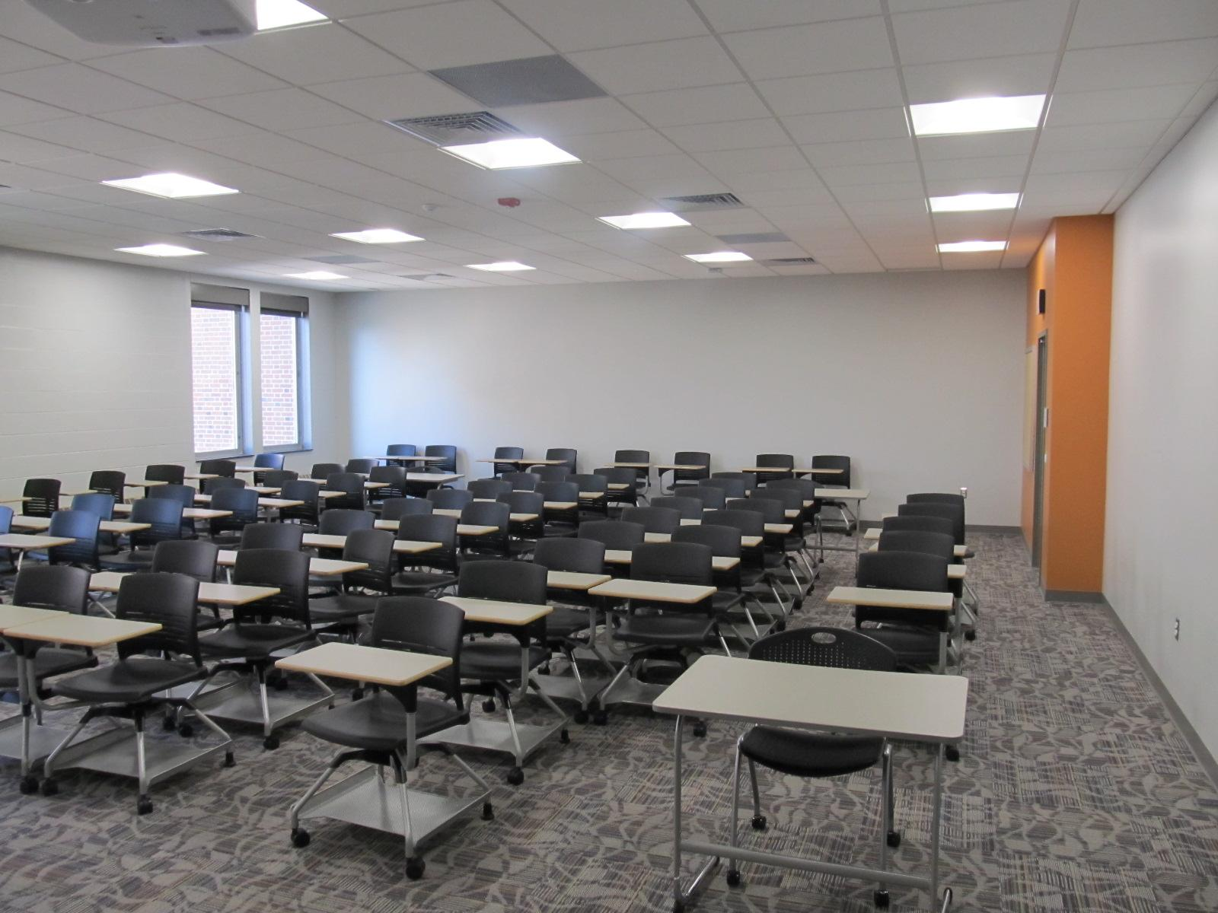
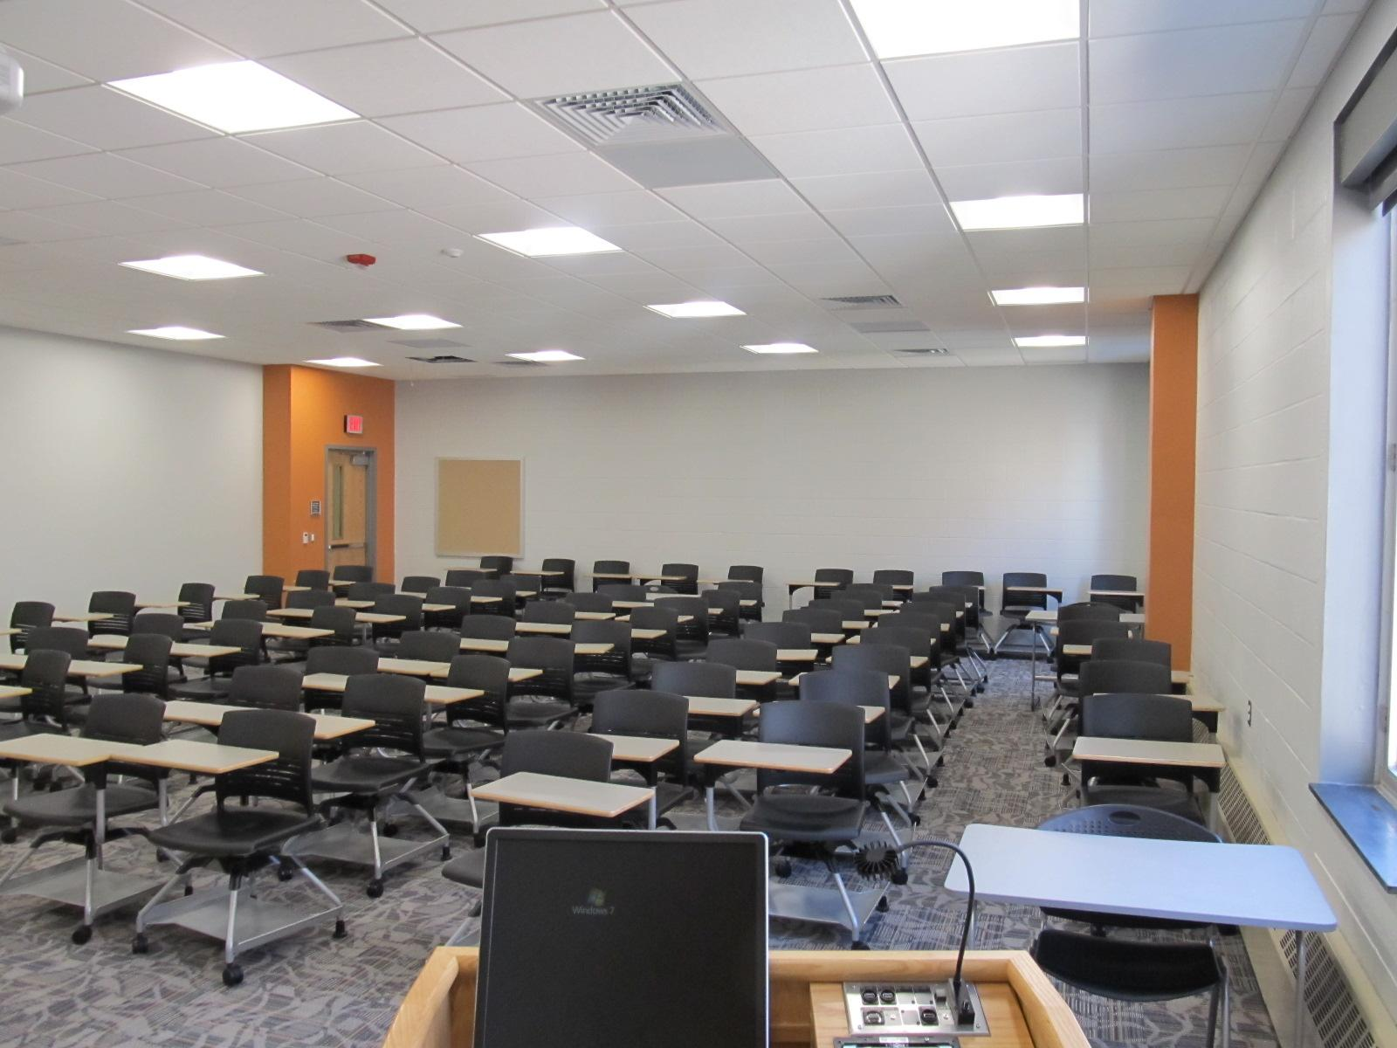
Learn 2 Collaborative Seating
Willard 258 - Seats 79
Willard 260 - Seats 105

Slide 6
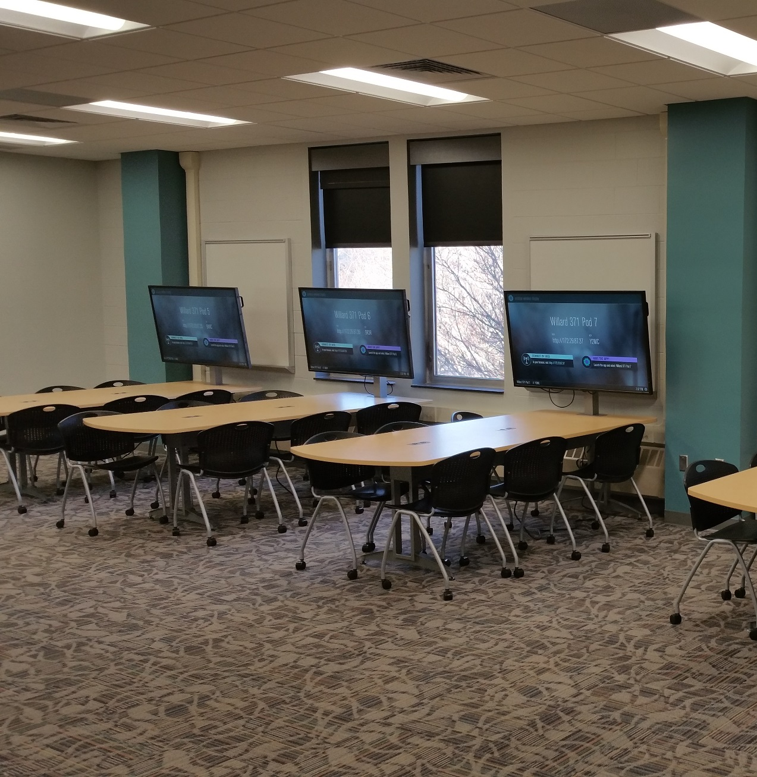
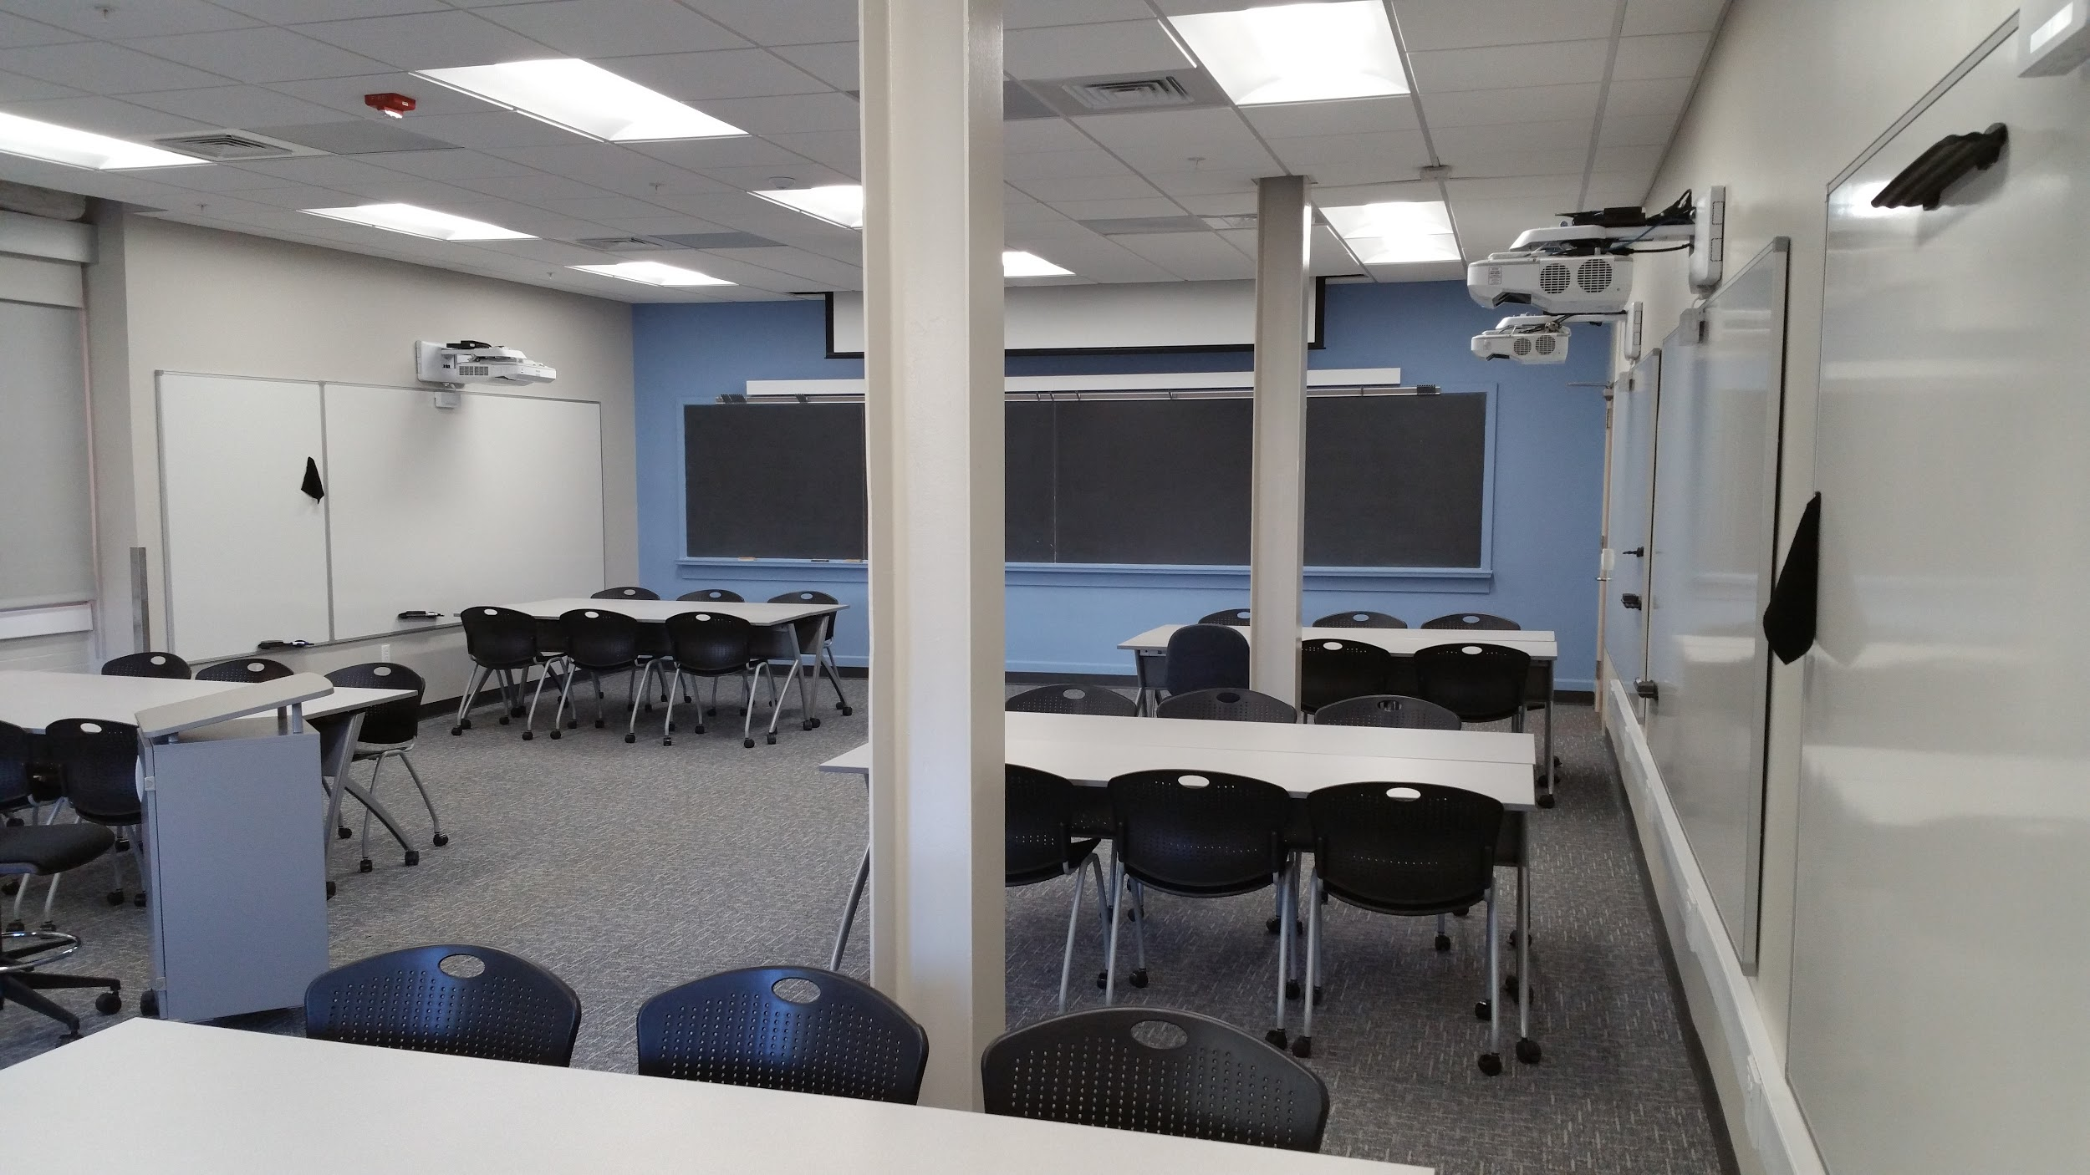
Media Sharing and Flex Learning
Willard 371 - Seats 48
Eng. Unit B 107 - Seats 30

Slide 7
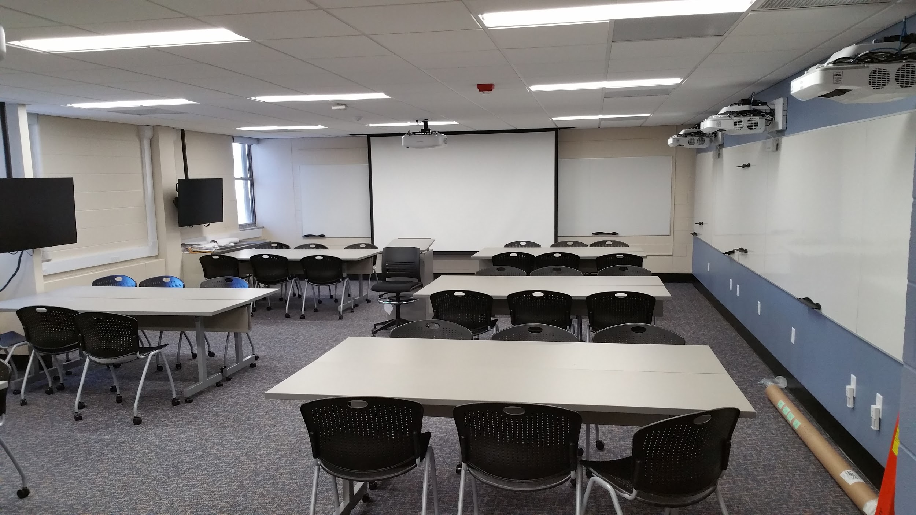
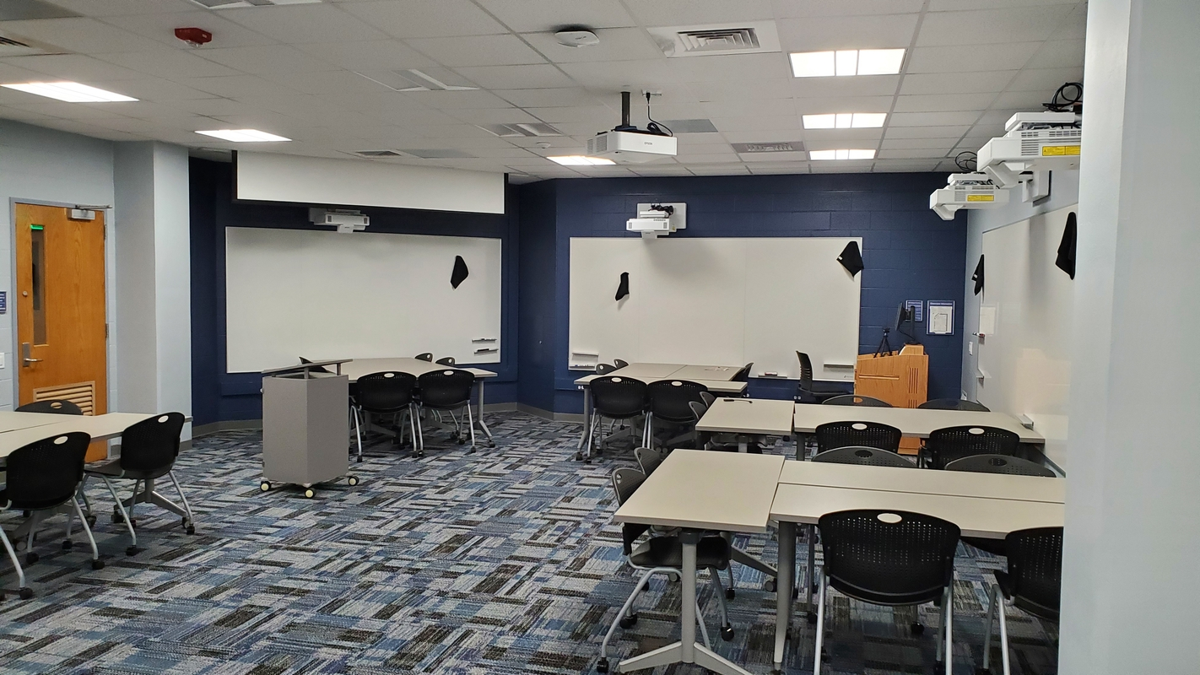
Flex Learning
Carpenter 107 - Seats 34
Walker 003 – Seats 42

Slide 8
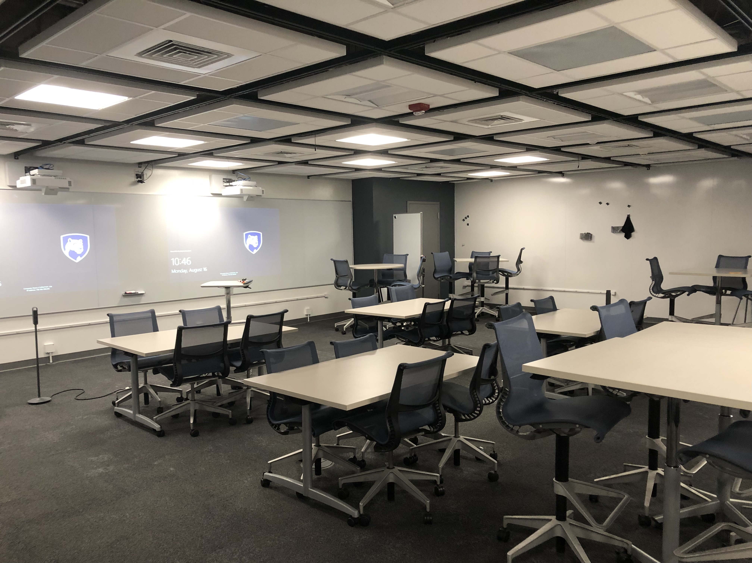
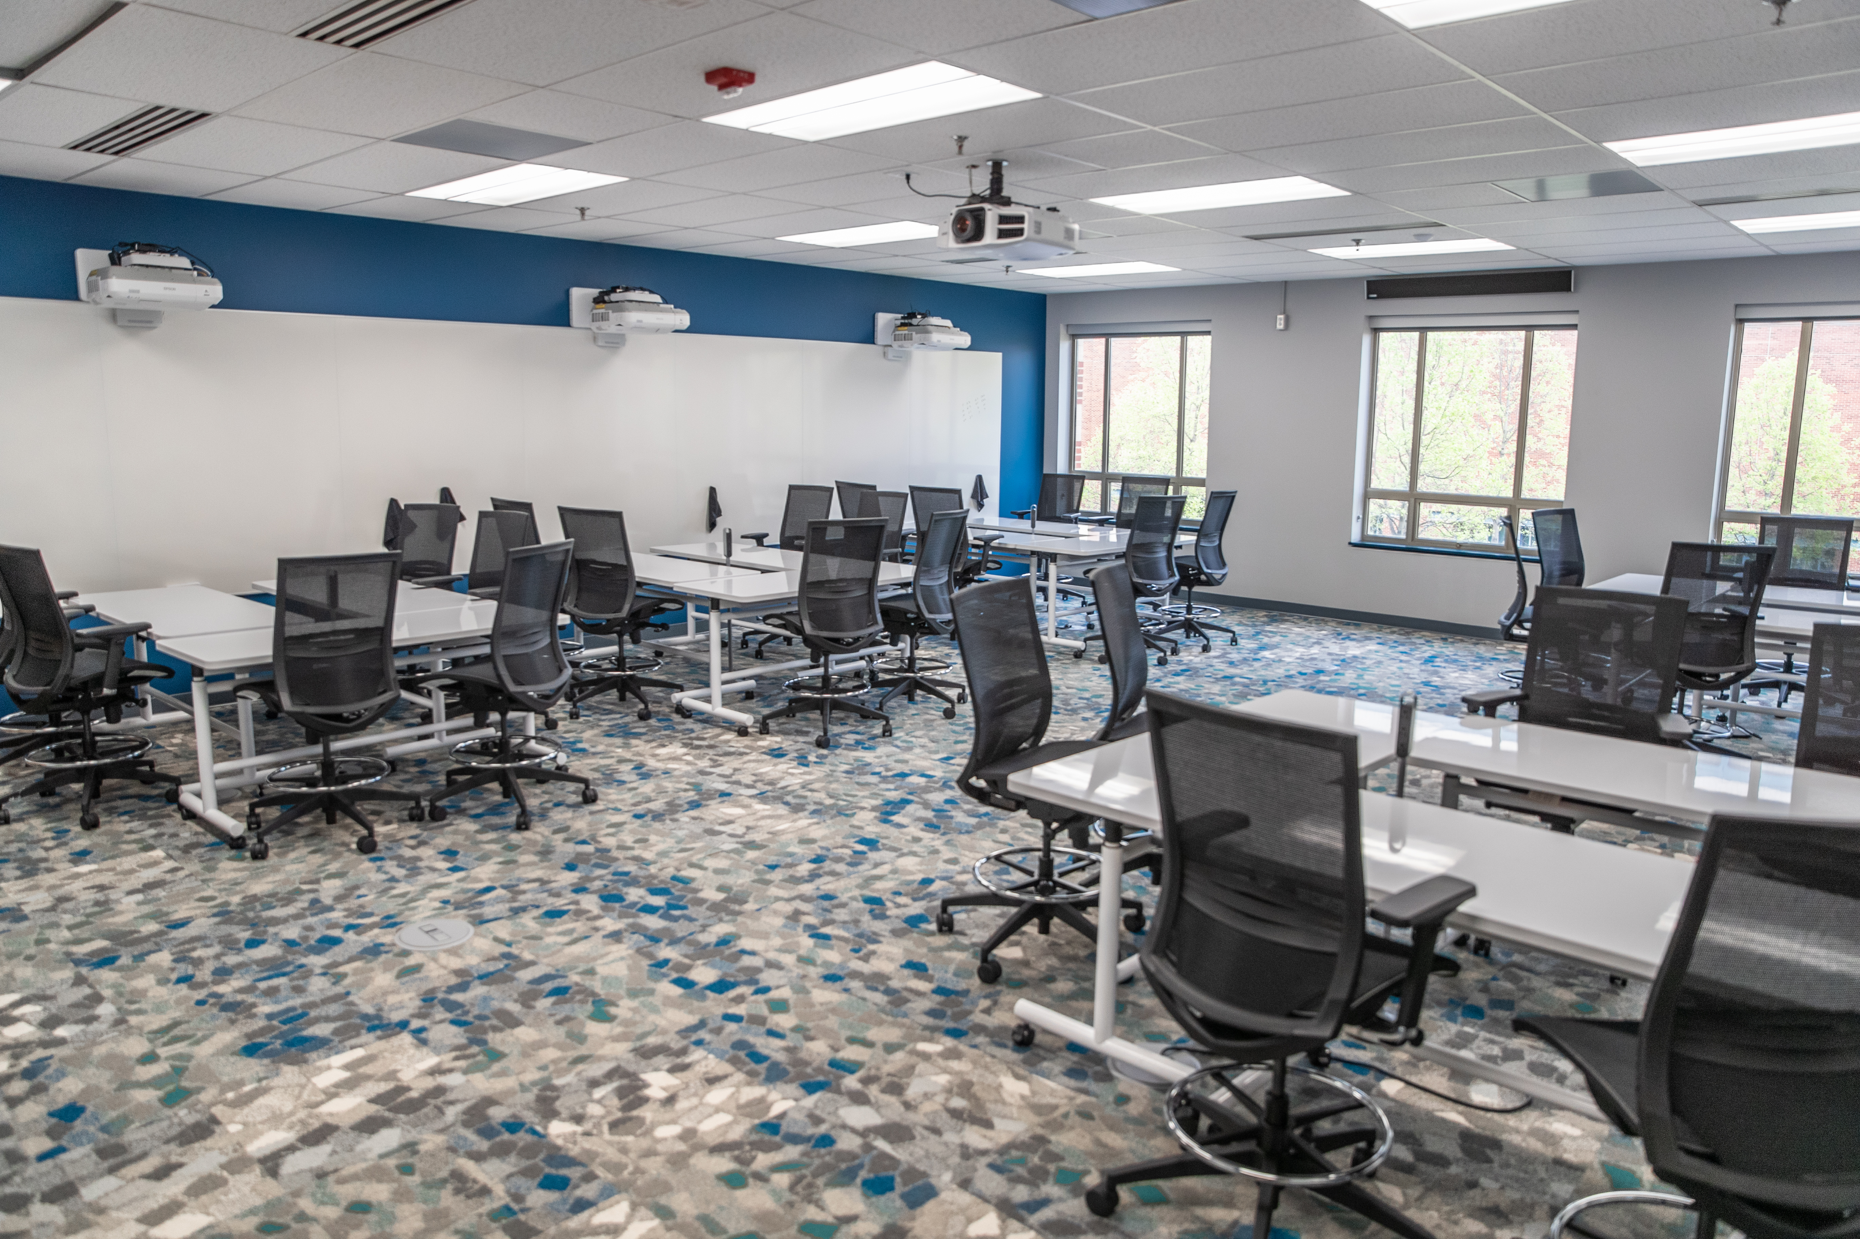
TLT Research Spaces – Flex Learning
Althouse 101 - Seats 44 *
TLT Scheduled - For Research
Ag Sci 110 - Seats 30

Slide 9
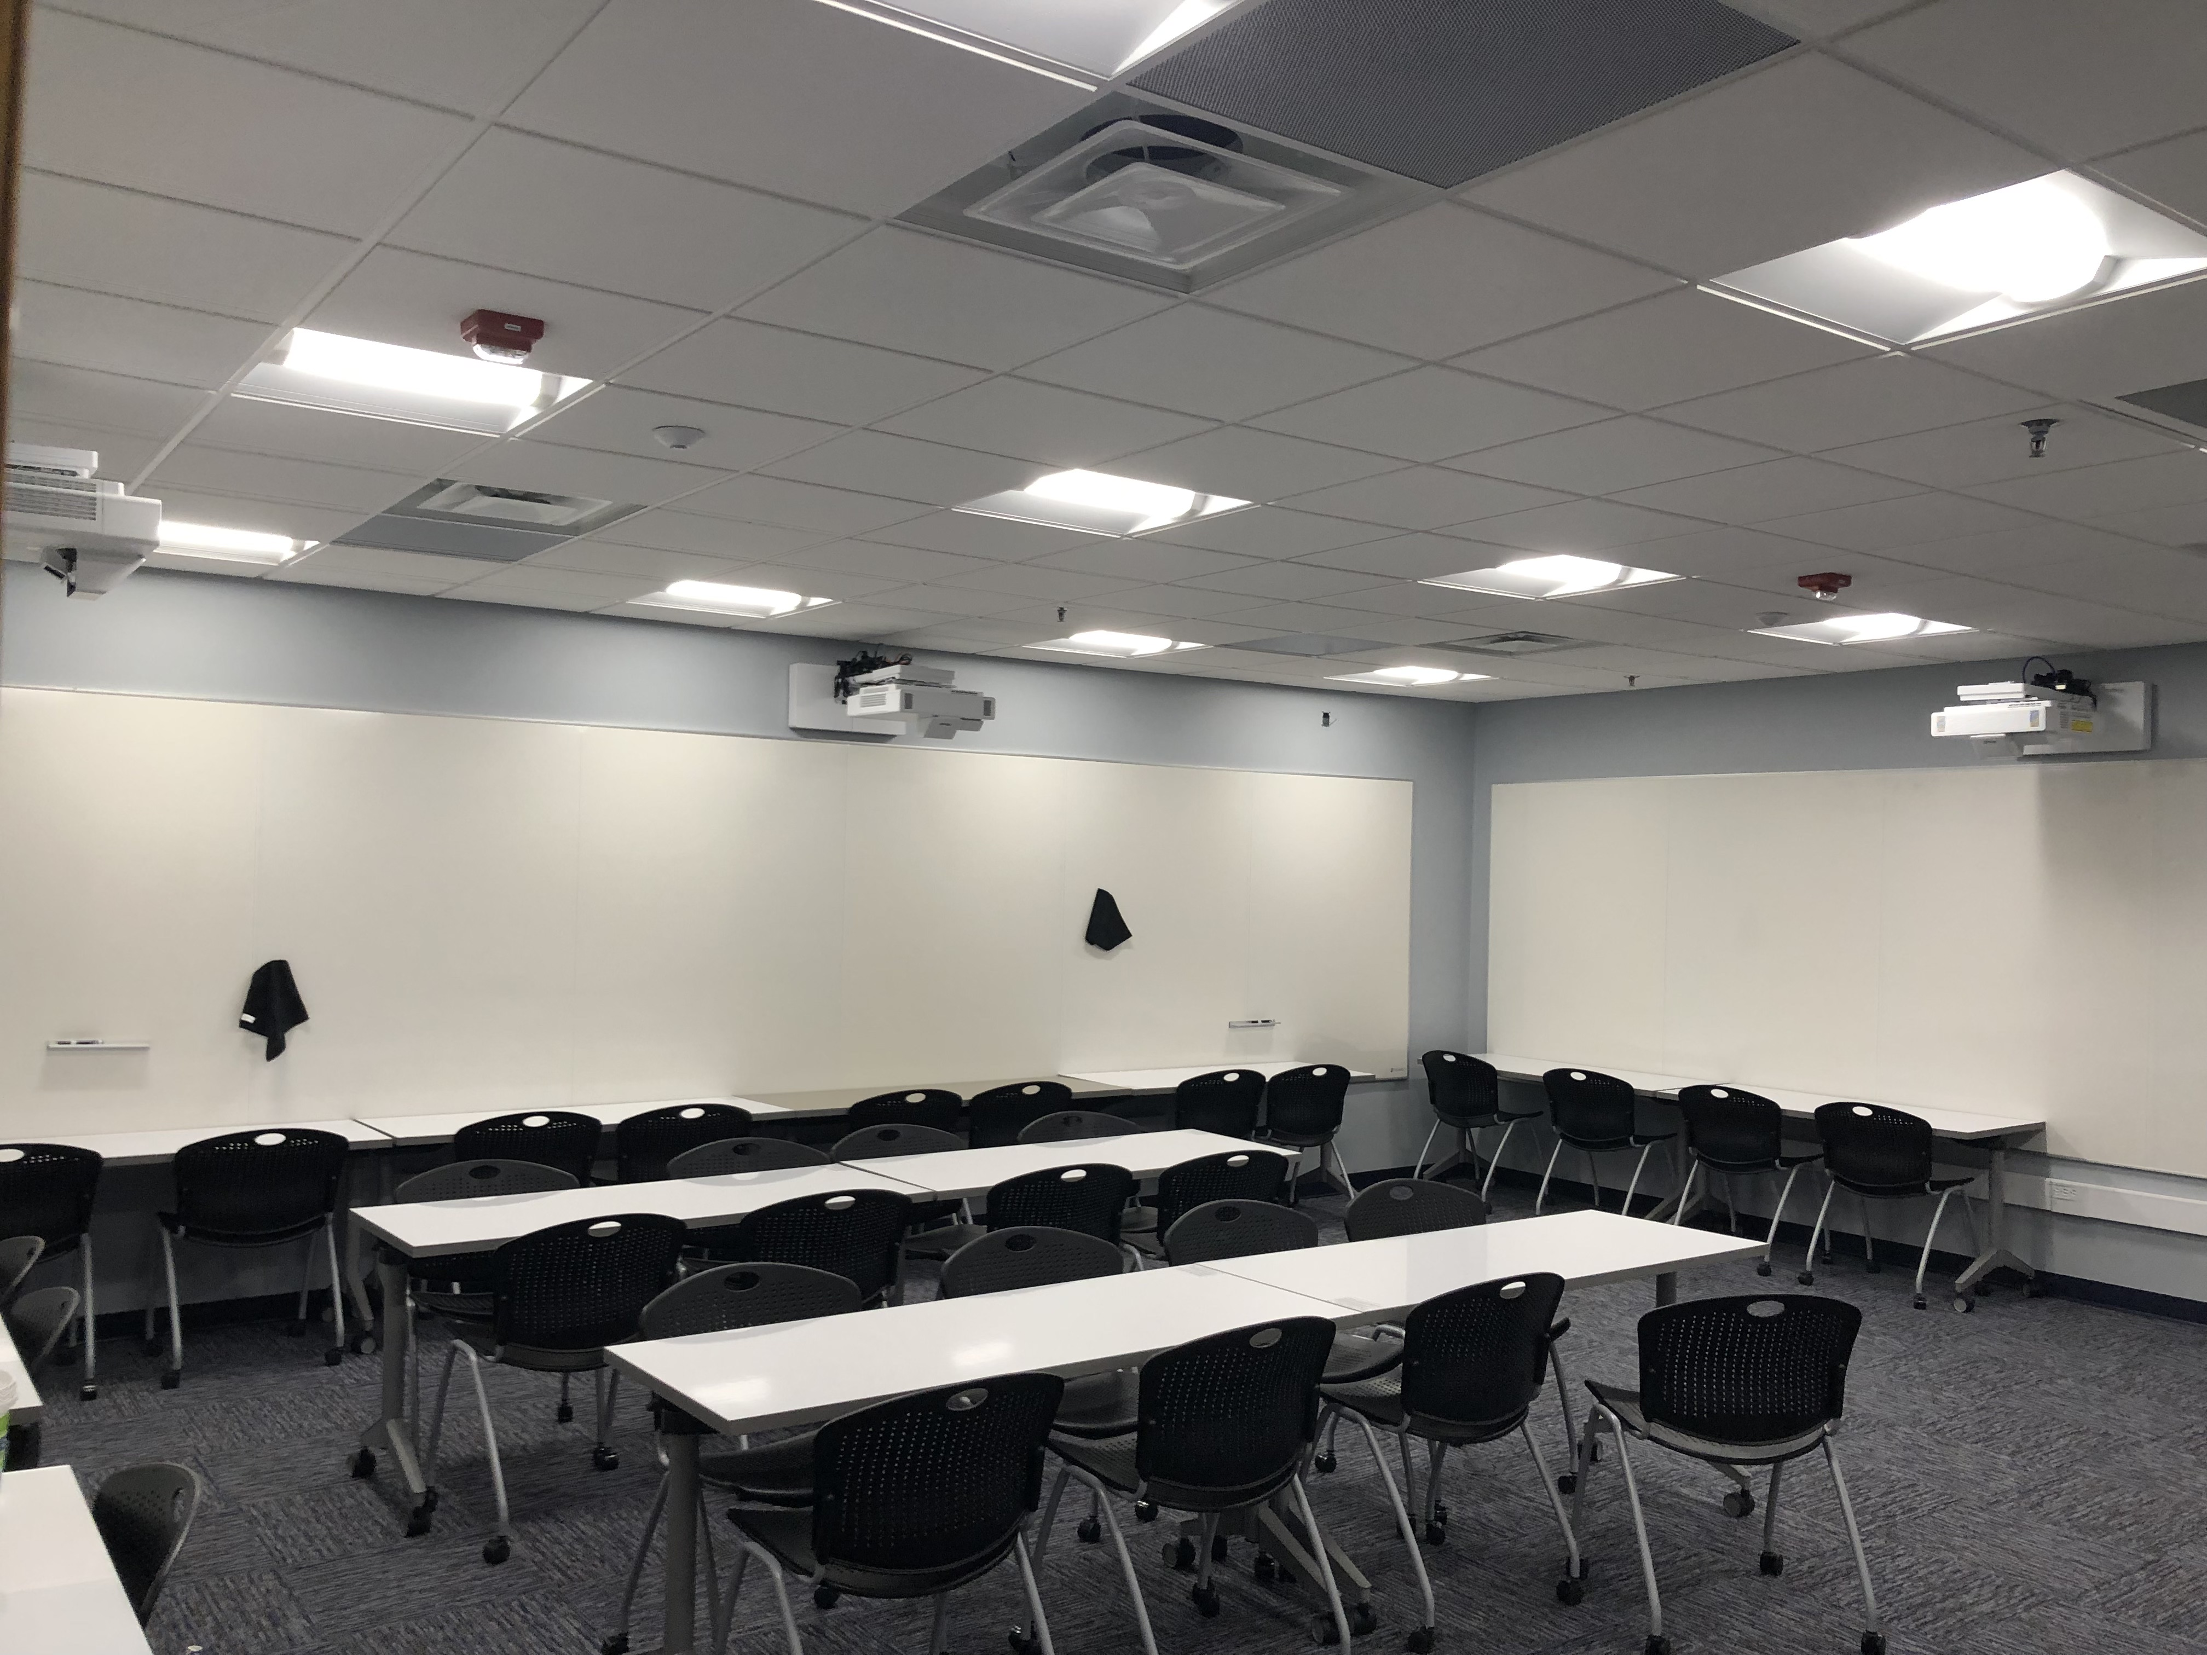
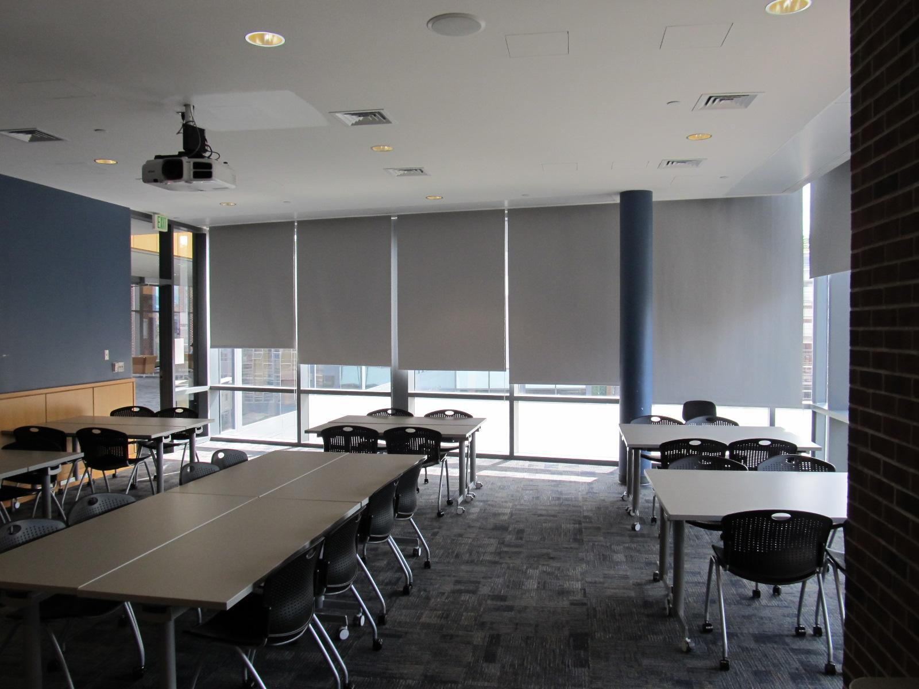
Other flexible spaces, continued
Ag Sci 106 – Seats 24
Life Sci 301D - Seats 32

Slide 10
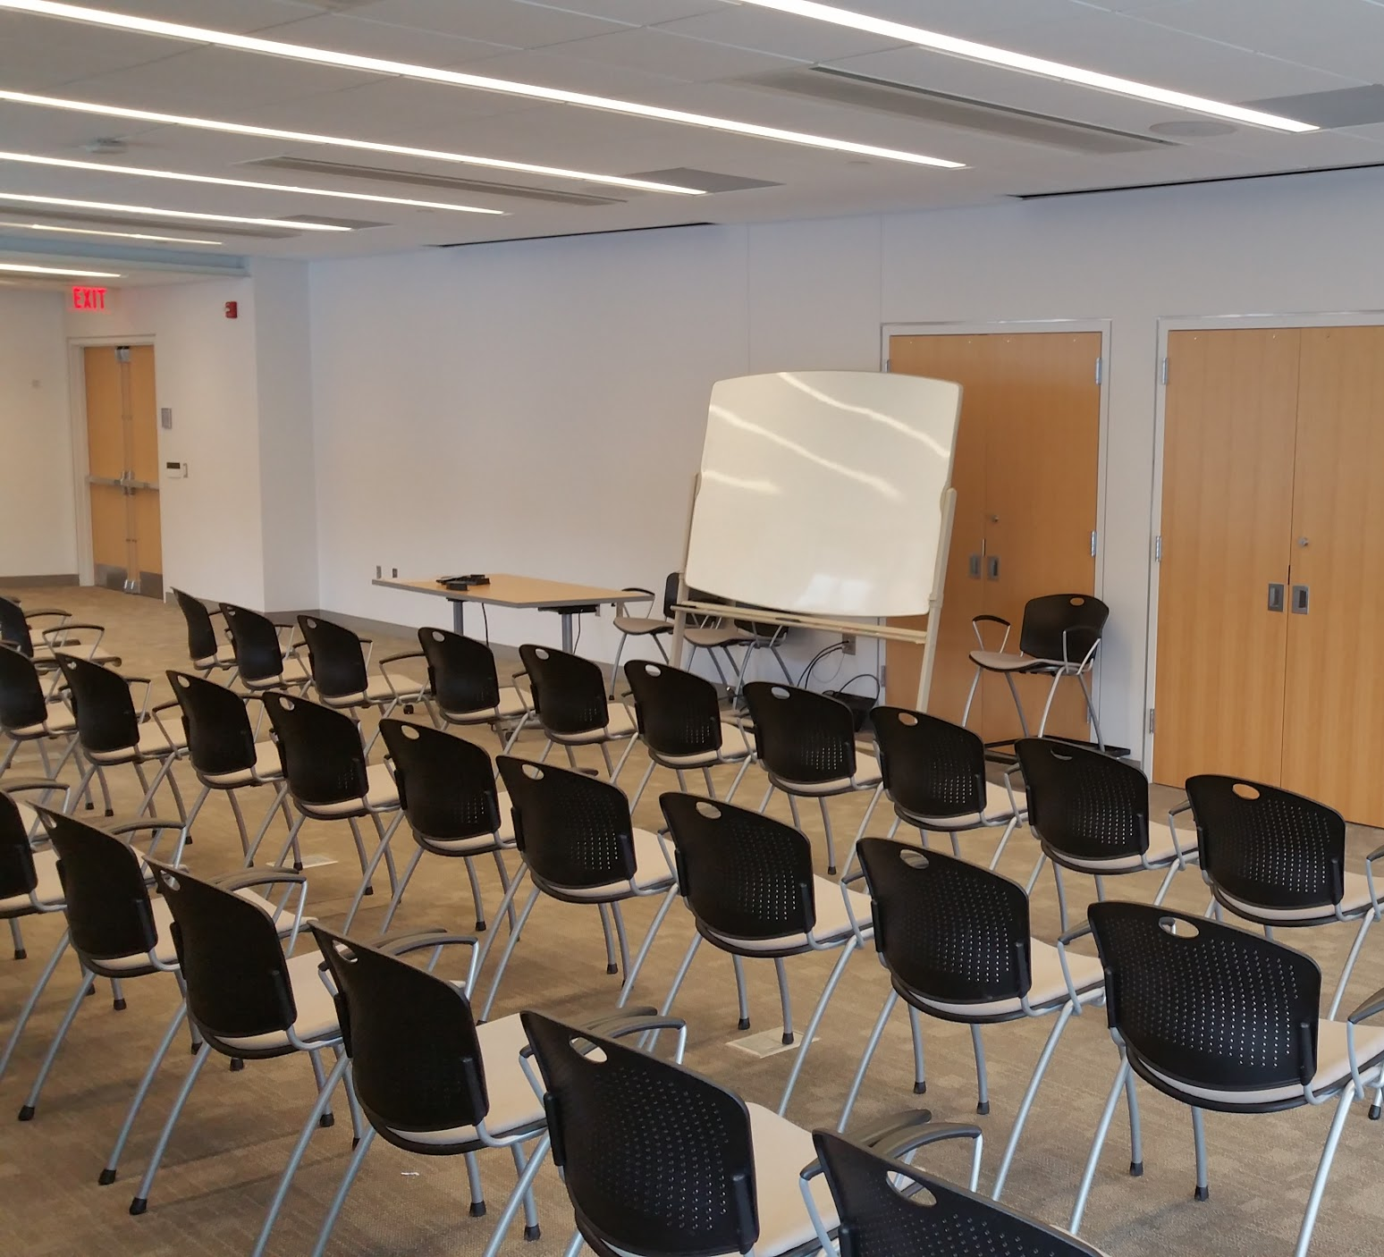
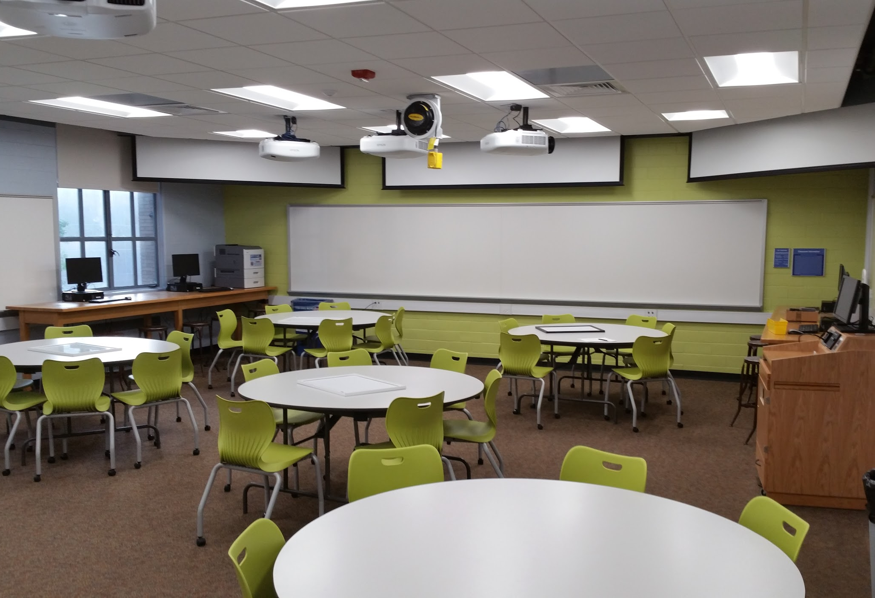
Other flexible spaces, continued
Moore 127 - Seats 40
Osmond 207 - Seats 46

Slide 11
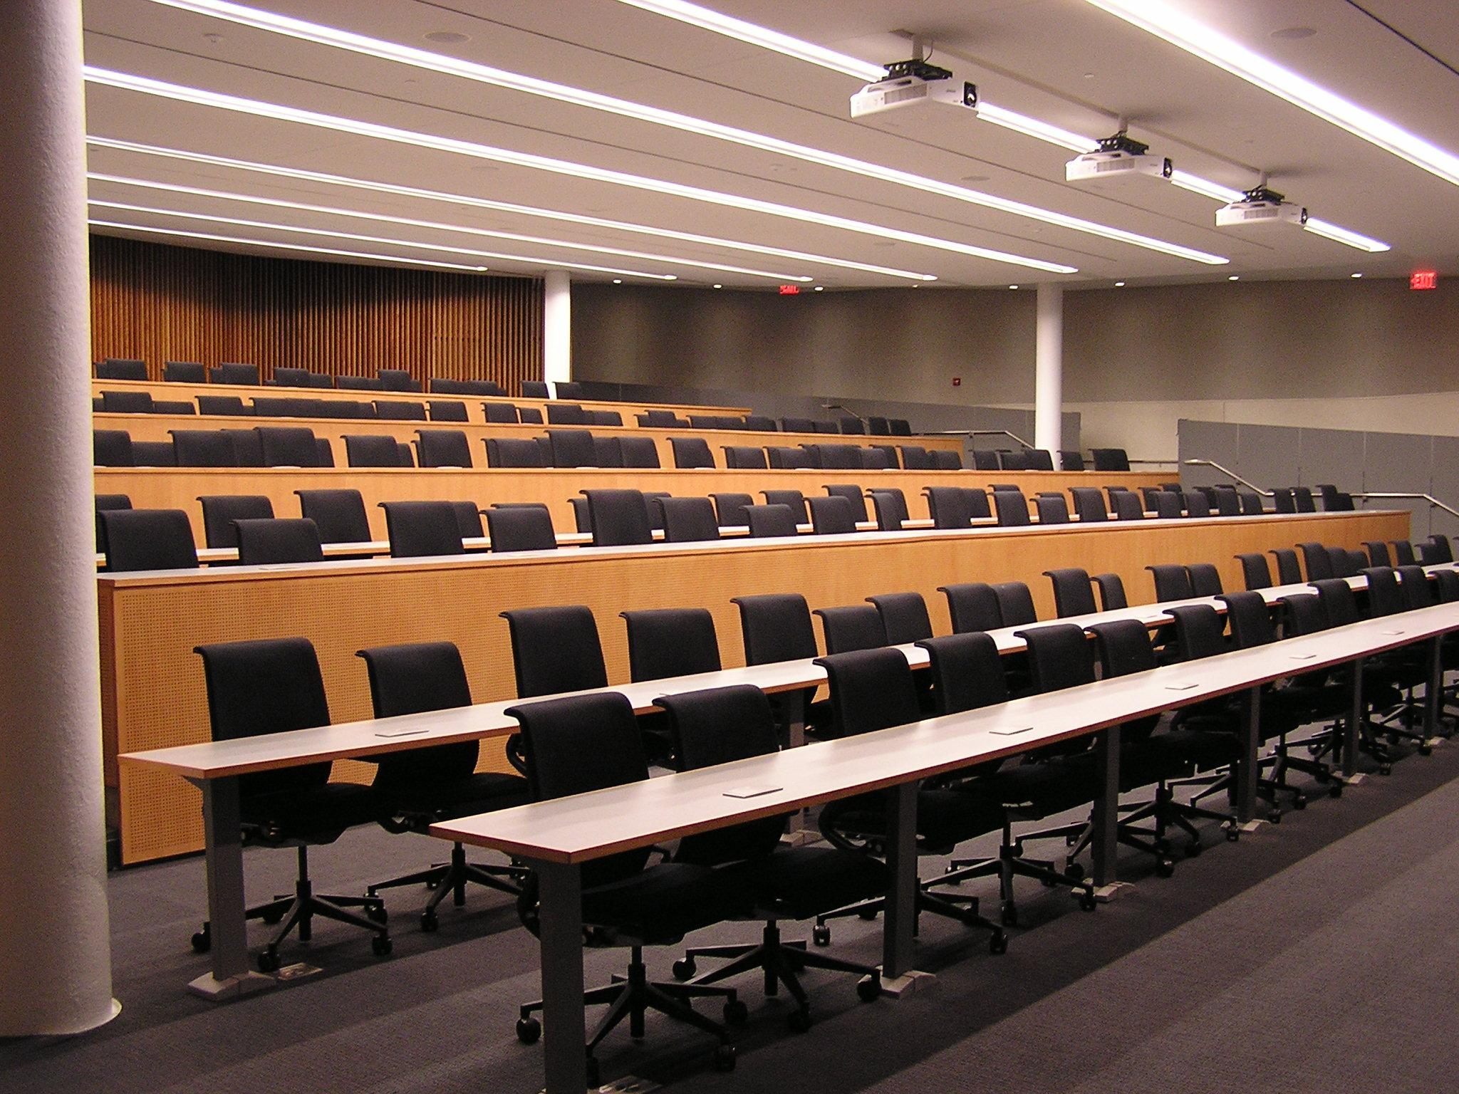
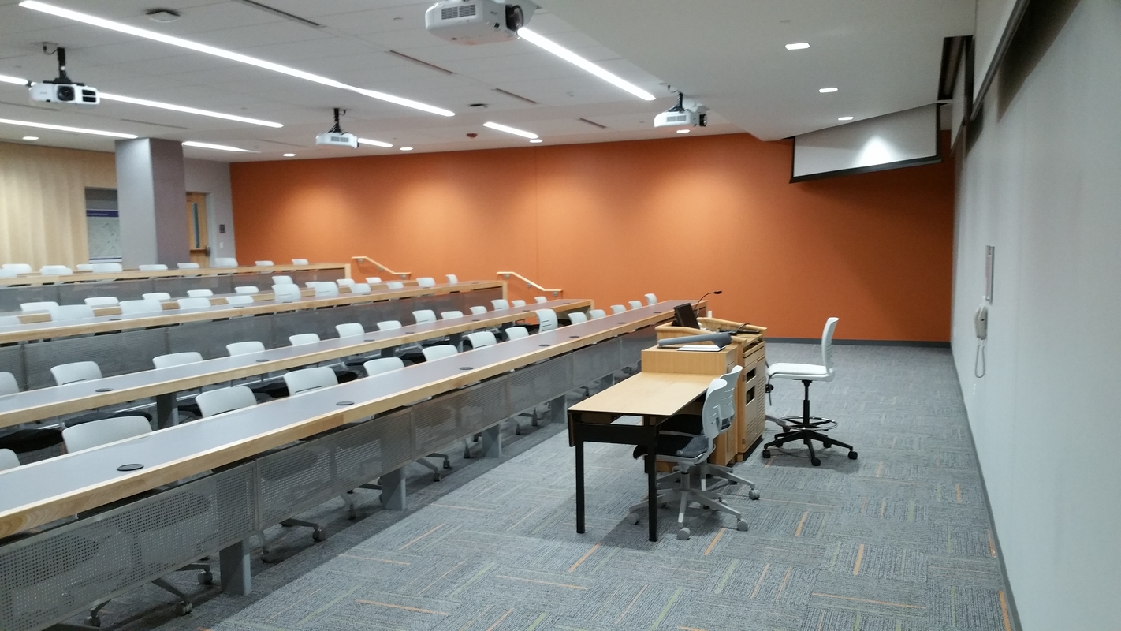
Turn to Team (Tiered classrooms)
BBH 22 - Seats 200
Steidle 114 - Seats 80

Slide 12
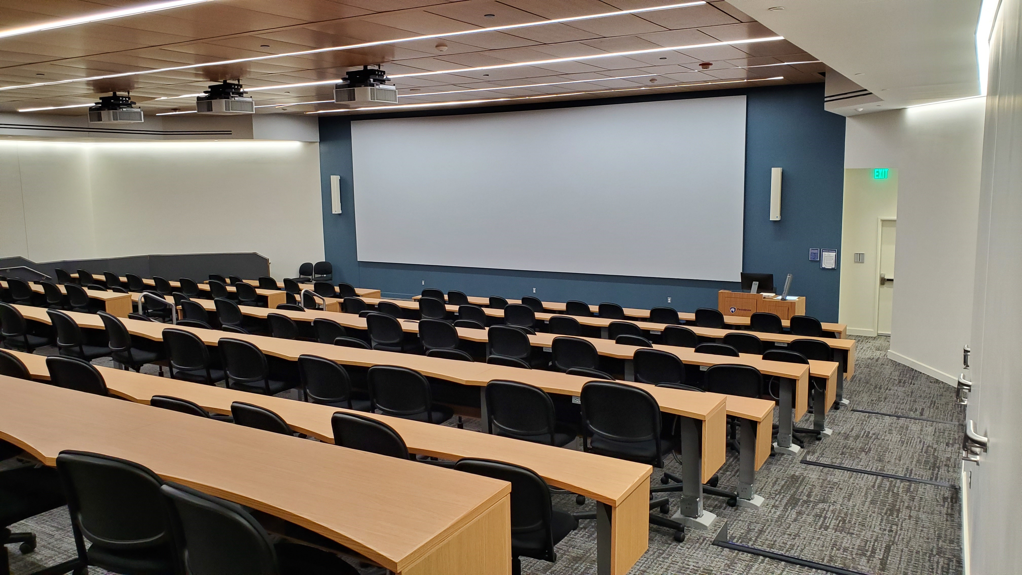
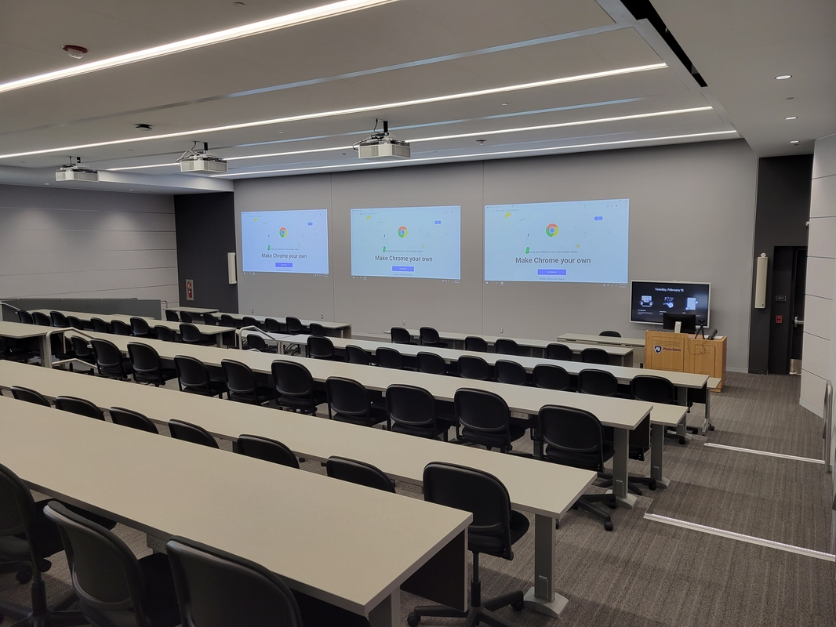
Turn to Team (Tiered classrooms)
CBEB 001 - Seats 160
AVBS 102 - Seats 120

Slide 13
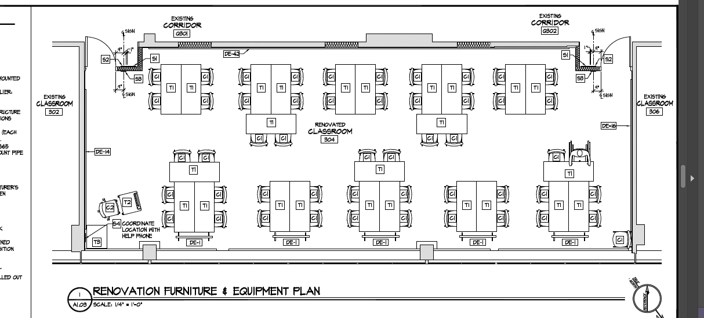
New Spaces – Coming Soon!
Boucke 304

Slide 14
Thank you!
Tim Linden
Learning Spaces Coordinator
thl111@psu.edu

Slide 15
Requesting Room Characteristics
Curriculum Management-Schedule of Classes-Maintain Schedule of Classes
Meetings Tab
Add the room characteristics needed for the class
Only enter quantity for STEC, STEC-PC, or STEC-Mac
Do not enter too many. The more you enter, the fewer rooms will be available for your use when the Optimizer runs.
Office of the University Registrar
www.registrar.psu.edu

Slide 16
Future Semester Timelines
Spring 2023
April 11-Class roll
June 17- Academic schedulers closed out of Spring 2023 at 5pm
June 22-Optimizer runs
July 27-Open access to Spring 2023
September 6-Publish schedule of courses
September 6-Events for Spring 2023 may be scheduled
September 21-Shopping cart opens
October 5-Priority registration begins
October 12-Regular registration begins
Office of the University Registrar
www.registrar.psu.edu

Slide 17
Future Semester Timelines
Summer 2023
July 11-Class roll
September 9- Academic schedulers closed out of Summer 2023 at 5pm
September 14-Optimizer runs
September 19-Open access to Summer 2023
November 14-Publish schedule of courses
November 14-Events for Summer 2023 may be scheduled
January 27-Shopping cart opens
February 1-Priority registration begins
February 2-Regular registration begins
Office of the University Registrar
www.registrar.psu.edu

Slide 18
Future Semester Timelines
Fall 2023
September 6-Class roll
November 4-Academic schedulers closed out of Fall 2023 at 5pm
November 9-Optimizer runs
December 14-Open access to Fall 2023
February 1-Publish schedule of courses
February 1-Events for Fall 2023 may be scheduled
February 22-Shopping cart opens
March 15-Priority registration begins
March 22-Regular registration begins
Office of the University Registrar
www.registrar.psu.edu

Slide 19
Final Exams
Deadline to request a final is always the Friday of the first week of classes by 5 PM for the Fall and Spring semesters:
Summer 2022
6WK1 – May 18th by 5pm
6WK2/Reg – July 1st by 5pm
Fall 2022 - August 26th by 5pm
Spring 2023 - January 13th by 5pm
Requests do not roll, every final is defaulted to “Not Specified”, so finals need to be requested every semester.
Office of the University Registrar
www.registrar.psu.edu

Slide 20
Finals Reminder
Requesting finals:
Curriculum Management-Schedule of Classes-Adjust Class Associations (Class Components tab)
ITEC-This means you are requesting a final and you want it in an ITEC room.
No-This means you are not going to offer a final during finals week.
Remote Asynchronous – To have an open WEB final during a specific day.
Remote Synchronous – To have a WEB final on a specific day and time.
STEC-This means you are requesting a final and you want it in an STEC room (not the same as eTesting and is not a secured browser).
VTEC-This means you are requesting a final and you want it in a VTEC room.
Yes-This means you want a final and you don’t have a room preference.
eTesting-This means you are requesting an eTesting final (remember, you cannot request an eTesting final unless your class had a test in the Testing Center during the regular semester and the class must be UGRD).
Office of the University Registrar
www.registrar.psu.edu

Slide 21
Finals Reminder
Grouping Classes Together
Curriculum Management-Schedule of Classes-Maintain Schedule of Classes (Exam tab)
For all classes that need to have their exam together at the same time and place
Enter a base section on all sections you want to meet together
You must complete this for combined sections
You cannot put in a subject that is not your own, so if you are going to have a final for a combined section, you must email esmail@psu.edu to have the grouping information added to the other subject.
Make sure that both subjects have the same final exam designation (No, ITEC, STEC, VTEC, Yes, eTesting)
Make sure both subjects have the same exam seat spacing
If you are grouping a final make sure that ALL sections that you are grouping are listing your initial section.
Office of the University Registrar
www.registrar.psu.edu

Slide 22
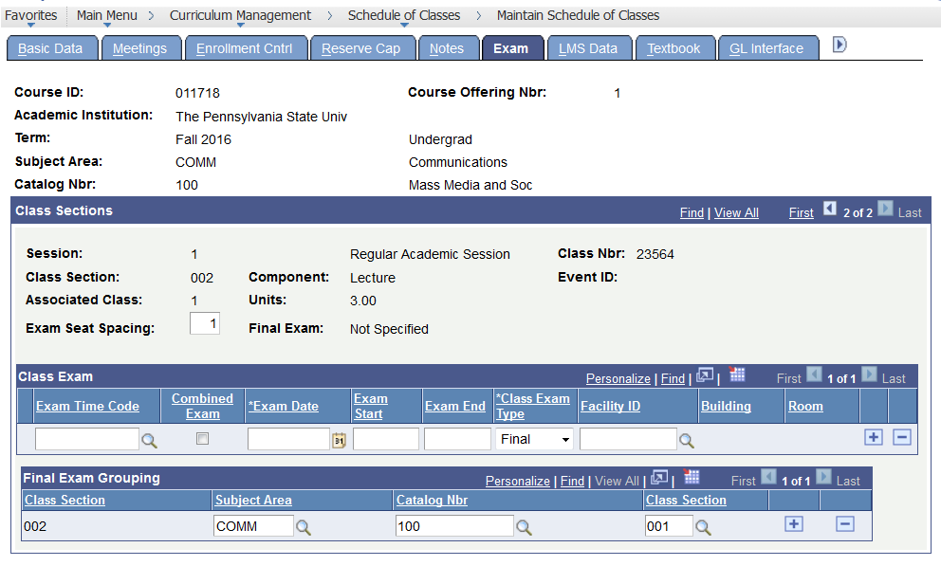
Finals Reminder
Office of the University Registrar
www.registrar.psu.edu

Slide 23
Finals Reminder
If the deadline for requesting a final exam is missed.
The final exam conflict schedule must be released prior to the instructor working with the students.
To reserve a room for the final you must submit an Event Room request form.
The exam will not be placed in LionPATH or the conflict exam application.
Room Changes
Possible final exam room changes must be received by Enrollment Services no later than the last day of conflict filing for students, after this time we will not make any adjustments to room listings so that we may better serve the students who have requested conflict exams.
Conflict filing period
Fall 2022 – September 26th till October 16th
Office of the University Registrar
www.registrar.psu.edu

Slide 24
Evening Exams
The scheduling of evening examinations in any course offered before 5:30 p.m. is permitted only when all of the following conditions are fulfilled:
Consent is granted by the dean of the college in which the course is taught.
No more than four evening examinations are scheduled during the semester.
The evening examinations are scheduled in advance by the Registrar's office and announced by the professor during the first week of classes.
Evening exam periods:
6:15 p.m. to 7:30 p.m. (75 minute period only)
8:00 p.m. to 10:00 p.m. (75 to 120 minute period)
Revised: ACUE (1-3-19)
Office of the University Registrar
www.registrar.psu.edu

Slide 25
Course Catalog
OUR will now be updating the course catalog in LionPATH with course changes, adds and drops.
Faculty Senate is still responsible for the review and approval of all courses. They are also still responsible for the proposal system CRSC. Questions regarding course content can be found at senate.psu.edu.
Special titled courses may be offered only two times. If the department wishes to continue to offer the course, it should be proposed as a permanent course.
There are two types of one semester title forms currently available:
One-Semester Title Courses Request Form - The completed form should be sent to the college dean’s office. Upon approval, the form will be forwarded by the dean’s office to the Office of the Registrar (catalog@psu.edu). Unless it is One semester honors in which it will go to Schreyer honors college for approval before Registrar.
One-Semester Integrative Studies Titles Request Form - After College approval forms must be sent to univfs@psu.edu for review before being added to the Course Catalog.
Office of the University Registrar
www.registrar.psu.edu

Slide 26
Pay Detail/Workload
Curriculum Management-Schedule of Classes-Maintain Schedule of Classes (Meetings tab)
Pay Detail needs to be entered for each instructor listed. This information will roll.
Remember that this is a pop-up, so make sure your blocker allows pop-ups from LionPATH
PE_RP_CLASS_MISSING_PAY_DTL
Don’t forget to enter workload
Office of the University Registrar
www.registrar.psu.edu

Slide 27
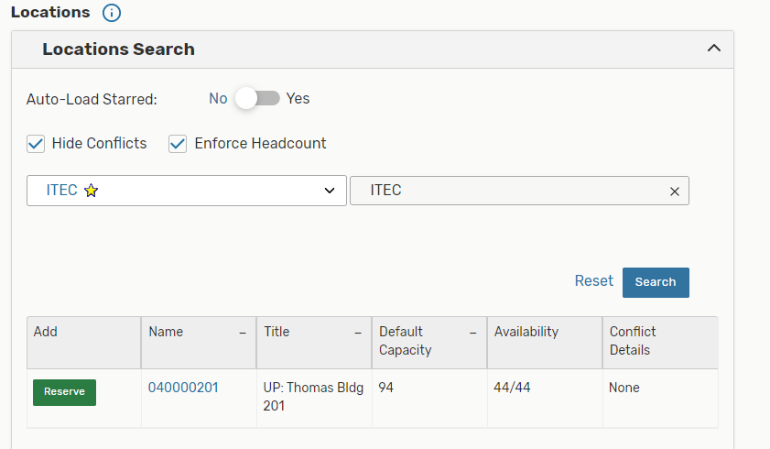
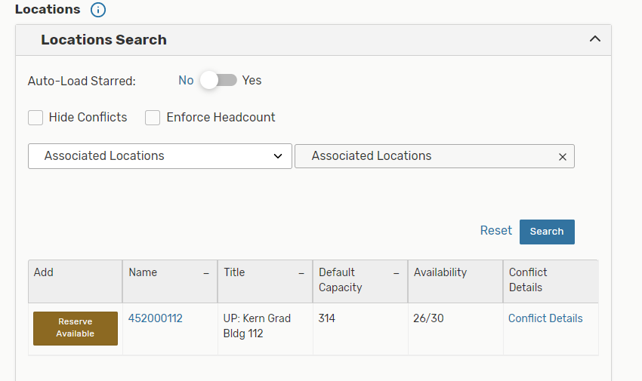
25Live Reserve vs. Reserve Available
Reserve= room is open all days your class meets (notice availability says 44/44)
Reserve Available= room is open for SOME of the days your class meets (notice availability says 26/30)
Office of the University Registrar
www.registrar.psu.edu

Slide 28
Fall 2022 Optimizer Run
7,114 classes went through the Optimizer
12 Optimizer runs completed-split up by class size
When the Fall 2022 Optimizer run was completed, we had 726 classes without rooms
As of this week, we have 332 classes without rooms
Office of the University Registrar
www.registrar.psu.edu

Slide 29
Fall 2022 Scheduling Issues
Departments not pre-assigning their department labs or department classrooms prior to the Optimizer run.
Many classes requesting Tuesday and/or Thursday meeting patterns- 514 of the 726 classes that didn’t get a assigned a room had a T, R, or TR meeting pattern
Classes asking for too many or conflicting room characteristics
Cross-listed classes not combined prior to Optimizer
Hybrid classes not cleaned up- Zoom or Web facility ID was missing from the online meeting pattern
Nonstandard classes- 165 of the 726 classes that didn’t get assigned a room were nonstandard
Loss of general-purpose classrooms
Office of the University Registrar
www.registrar.psu.edu

Slide 30
Classrooms
Losses
232 BBH- 16 seats
N205 Millennium- 18 seats
122 Pond- 25 seats
123 Pond- 20 seats
114 Earth & Engineering Science- 119 seats
116 Earth & Engineering Science- 35 seats
112 Osmond- 45 seats
113 Osmond- 36 seats
115 Osmond- 45 seats
116 Osmond- 36 seats
117 Osmond- 159 seats
119 Osmond- 351 seats
216 Osmond- 24 seats
Gains
108 Waring- 47 seats
102 Animal, Veterinary, and Biomedical Science- 120 seats
Office of the University Registrar
www.registrar.psu.edu

Slide 31
Contacts
esmail@psu.edu is for questions about classes, exams, 25Live, course catalog, course controls
registrar@psu.edu is for questions about students and enrollment
If you have new schedulers for your department, please let us know so we can update our mailing lists.
Reminder that we have a website that deals with all things course scheduling https://www.registrar.psu.edu/faculty-staff/scheduling/index.cfm
Office of the University Registrar
www.registrar.psu.edu

