Slide 1
Academic Schedulers Meeting 2023

Slide 2
Agenda
Student Laptop Initiative
Instruction Modes
Instructor Pay Detail
Free/Reduced Course Material
Room Characteristics
One Semester Title Classes
Distribution of Classes and Room Requests
Best Practices
Random Reminders
Q&A

Slide 3
Laptop Initiative

Slide 4
Program Backstory / Timeline
We are here
Spring 2021
Summer 2021
Fall 2021
Spring 2022
Fall 2022
Spring 2023
IST Pilot -> Requirement
Provost charges
Oversight Committee
4 Task Forces
(40+ faculty/staff)
Final Report
Implementation
Committee
Rich Bundy
Michael Busges
David Callejo
Yvonne Gaudelius
Melissa Kunes
Justin Schwartz
Andrew Sears
Technical Specifications
Financial Aid & Purchasing
Infrastructure
Pedagogy
Awareness
Notes:
Angie
In Spring 2021, Provost Jones charged an Oversight Committee with the representatives listed to investigate a laptop requirement for students. We were seeing peer institutions requiring and some even purchasing devices for their students.
You will see there were two parallel paths – IST pilot and task forces
IST piloted a laptop requirement for Fall 2021 which provided the opportunity to learn what it meant to require laptops for students and how that impacted the student and faculty experience.
4 task forces: Pedagogy, Infrastructure, Purchasing, Specifications
-over 40 total faculty and staff
Final report
-synthesis of task force reports
The final report was presented to Provost Jones and now we’re at a point where we’re implementing the recommendations of the report and sharing our findings and plans with the university. We don’t want any of this to be a surprise or any part of the university to feel left out of this discussion.

Slide 5
Key Findings
No requirement is needed – laptops are here
Many pieces in place, more coordination and communication needed
Instructional design required to increase laptop use in classrooms
Notes:
Angie
So what did the report actually say?
First and most important is that we don’t need to require laptops because they’re already here. We surveyed first year students using two different surveys and found that 96% of them already had a laptop. Laptops were already becoming more common but remote learning during the pandemic has made laptops ubiquitous.
We have some specific recommendations for the 4%, so I want to acknowledge that the adoption isn’t 100%
WE have many different programs in place to support student laptop needs but they need more coordination and improved messaging about what’s available to students at the right time in the student journey.
We need to leverage our instructional design resources to incorporate these devices into the teaching experience so they’re not just a mechanism to look at slides, take notes, or even be a distraction.

Slide 6
Laptop-Enabled University
Supports laptop needs of students at all campuses
Supports faculty to incorporate laptops into the curriculum on an opt-in basis
Enhances growth of mobile computing in educational environments
Ensures digital equity for all students
Notes:
Angie
As we thought about moving away from the idea of a requirement and recognizing the laptops are here, we want to provide some vision about what a laptop-enabled university looks like.
Support the needs of all students at all campuses, in the spirit of OPS 2025.
Support faculty in incorporating these laptops into the classroom experience.
Infrastructure would not just accommodate but enhance the growth of mobile computing
Ensuring that any student regardless of financial need or experience with having a laptop, would be given the tools to be successful.

Slide 7
Phase 2 Activities
Five Task Forces
Communications
Financials
Infrastructure
User Success
Pedagogy
Notes:
In support of this, five task forces were formed

Slide 8
Laptop Support Program
Address pedagogy needs of faculty and learning needs of students
Ensure infrastructure programs address growing laptop need
Establish discrete laptop performance levels across university
Repurpose laptop loaner programs for short and long term needs
Develop philanthropy program for students with financial need
Provide students/families resources on laptop purchasing
Establish communications plan
Notes:
To accomplish that vision, we’re recommending a Laptop Support Program. I think of it as an umbrella program that coordinates, focuses, and enhances existing activities and resources.

Slide 9
Next Steps
College of IST at University Park has moved from pilot into a full laptop requirement
Create awareness of program
Implement plan
Project structure
Appoint implementation committee
Continue working on 5 priority areas during Spring/Summer/Fall 2023

Slide 10
Pedagogy Task Force Charge
Assist in the designation of laptop-required courses in LionPATH.
Curate and create resources, events, and others faculty engagements related to this effort.
Assist in communication and dissemination of information and resources.

Slide 11
Laptop Designation Language
Students are REQUIRED to bring a laptop computer for in-class activities.

Slide 12
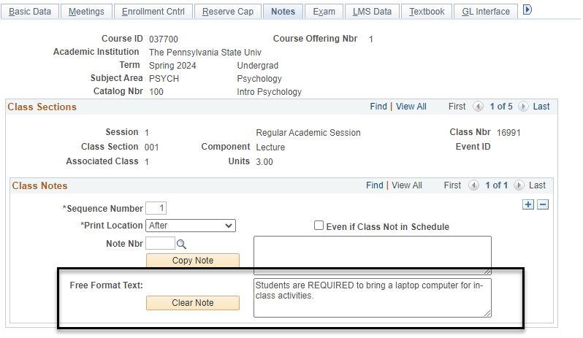

Slide 13
Resources
LionPATH query
PE_SR_SCHED_CLASS_N0TES will allow you to see any classes for a specific term, campus, and subject that have a class note

Slide 14
Instruction Modes

Slide 15
Instruction Modes
New instruction modes effective Fall 2023
Remote Asynchronous (RA): Class meets remotely. 100% of the class will be taught remotely asynchronously. (Formerly WB)
Remote Synchronous (RS): Class meets remotely at days/times listed. 100% of the class will be taught remotely synchronously. Instructors can offer up to less than 25 percent of a Remote Synchronous class remotely asynchronously, a flexibility to manage their own absences, whether due to illness or other unavoidable circumstances, during travel, or for pedagogical reasons.
Remote Blended (RB): Class meets 100% remotely. The class will be intentionally taught remotely combining asynchronous and synchronous (at days/times listed) instruction.

Slide 16
Instruction Modes
If you offer any classes with the instruction mode of web (WB), it will need changed to the new mode of remote asynchronous (RA) beginning with the Fall 2023 semester. Please go in and change those classes now for Fall 2023, Spring 2024, and Summer 2024.
The hybrid designations (H2, H5, and H7) should only be used if your class has a need for the student to be on campus for classes or exams.
If your class is going to be completely online for all classes and exams, you should be using one of the remote options (RA, RS, or RB).
The remote blended (RB) mode will be reported as 50% of your class is being taught asynchronously. This could have implications for international students and PHEAA recipients.

Slide 17
Instruction Mode Resources
https://www.registrar.psu.edu/registration/instruction-modes.cfm
New Instruction Modes Overview
Instruction Modes Flowchart
Flowchart and Guidelines for Academic Administrators and Faculty for Remote Synchronous Instructional Mode

Slide 18
Instructor Pay Detail

Slide 19
Student Credit Hours
Student Credit Hours (SCH) are assigned based on the instructor pay budget (Pay Detail) associated with an instructor
All instructors for a class should be listed and an instructor pay detail should be entered for each instructor for each section of a course
Pay Detail should be as specific as possible:
UPLA vs UPLA_ENGL
Cross-listed classes should have the same instructor pay detail assigned to them and should list the department (academic organization) that is paying the instructor.
MATH 414.001 is cross-listed with STAT 414.001 and the instructor is being paid by the STAT department, MATH 414.001 and STAT 414.001 should list the academic organization of UPSC_STAT in the Pay Detail box.

Slide 20
Student Credit Hours
If teaching assistants or graduate assistants are listed as instructors in LionPATH, the Pay Detail should be populated with the academic organization of the budget that is paying the true instructor
Multi-component classes that have lectures, labs, recitations, etc. should list the Pay Detail for the instructor on all components of the course
Only one academic organization can be listed in Pay Detail
All meeting patterns of a class should have the Pay Detail for the instructor populated
Meeting pattern 1 is MWF 8:00am-8:50am
Meeting pattern 2 is Web

Slide 21
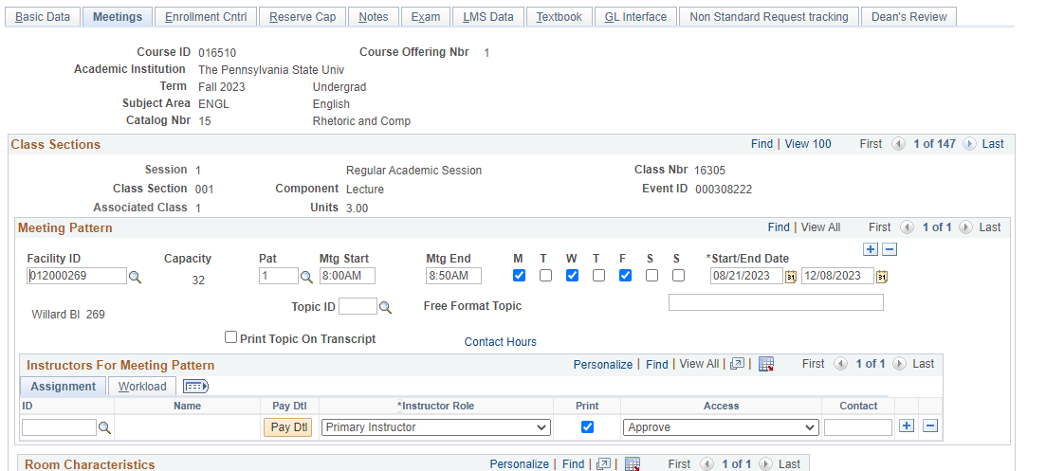
Instructor Pay Detail Information
Entered in LionPATH in Maintain Schedule of Classes on the Meetings tab

Slide 22
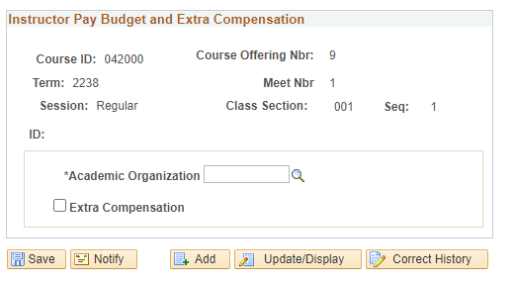
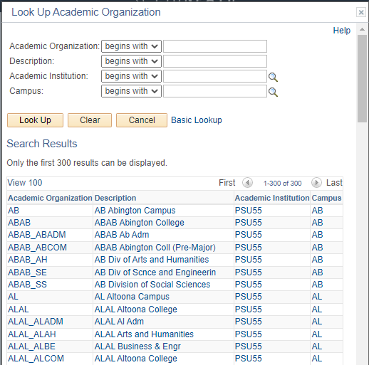
Instructor Pay Detail Information
Pay Detail is a pop up, so staff must allow LionPATH to pop up
Staff have the ability to enter any academic organization that exists in LionPATH

Slide 23
Reports
LionPATH queries
PE_RP_CLASS_MISSING_PAY_DTL- will allow you to see any classes for a specific term, campus, and subject that are missing a Pay Detail
PE_SR_CLASS_TERM_COLLEGE and PE_SR_CLASS_TERM_SUBJECT-will show the Pay Detail assigned to any class
iTwo
https://itwo.psu.edu/analytics/saw.dll?Dashboard
Documentation
FAQ
Budget Allocation Model – Student Credit Hours Dashboard
Information about Budget Allocation
https://budgetandfinance.psu.edu/budget-allocation-approach

Slide 24
Free/Reduced Course Materials

Slide 25
Free/Reduced Course Materials Course Markings Initiative
Marking course sections that use no-cost ($0 cost to the student) and low-cost (less than $50 in total) resources as required texts is a growing part of the college and university affordability landscape. “Course Marking” is commonly done by adding some type of notation to a course section in the course registration system so that students can readily see that notation when making course selection decisions. The Penn State Course Marking Initiative provides course schedulers with the opportunity to “mark” a course section as no-cost or low-cost by assigning an appropriate attribute to that section in LionPATH.
For the purpose of course markings, “required texts” are defined as textbooks, workbooks, homework systems, and other required learning content. Technology and supplies are not included in this definition and would not be addressed by this initiative.

Slide 26
Why Course Markings?
Marking courses as “affordable” in LionPATH would increase cost transparency and provide students with the ability to better plan for course costs. It is an important component in support of Penn State’s strategic plan foundation of Enabling Access to Education and our related access and affordability efforts. Importantly, providing course markings has been a recurring request from Penn State students expressed through our student government organizations.
State and federal legislation have played a significant role in laying groundwork for open and affordable course marking. Seven states passed course marking mandates between 2015 and 2019 (Oregon, California, Washington, Texas, Colorado, Virginia, and Louisiana), and these bills have foundations in an earlier federal requirement that introduced textbook information into course schedules. Many other institutions have also implemented affordable course markings or are in the process of doing so as a matter of policy.

Slide 27
How are courses marked?
When entering information about a course section in LionPATH, course schedulers have the opportunity to use a new course attribute:
“Required Text Cost”
that has two associated values to identify a course section as using no cost and low-cost required texts (excluding technology & supplies):
“No-cost Required Text ($0)” and “Low-cost Required Text (<$50)”
NOTE: Once a course section has been assigned the “Required Text Cost” attribute, that attribute will roll over each semester with the other course section information. Course schedulers will need to remove the attribute or change its value if there are changes to the required texts for that section in future offerings.

Slide 28
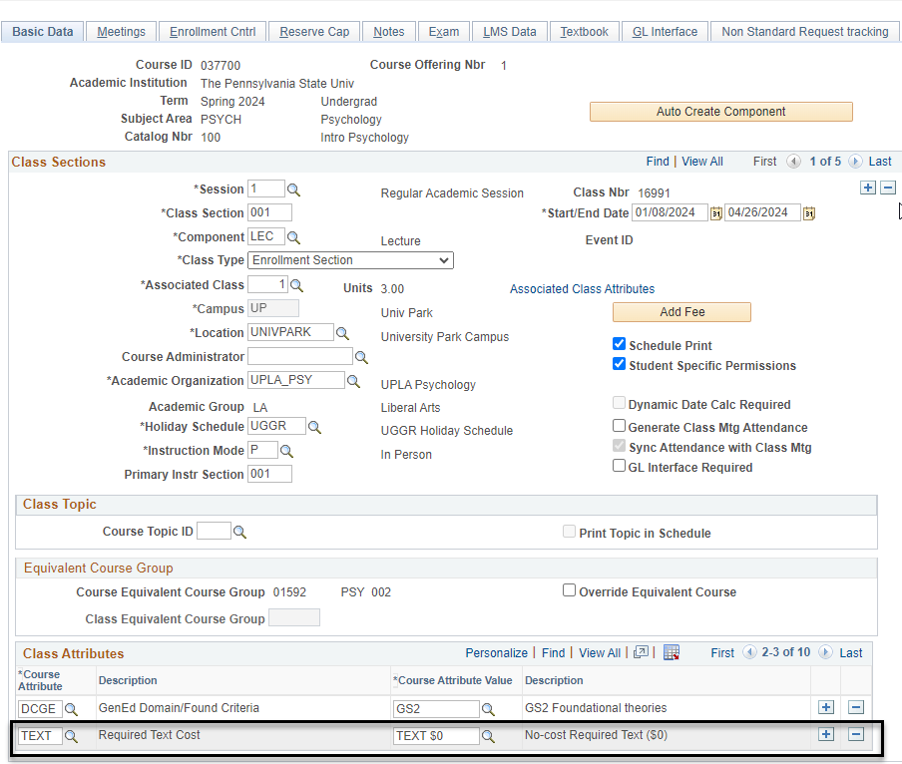
How are courses marked?

Slide 29
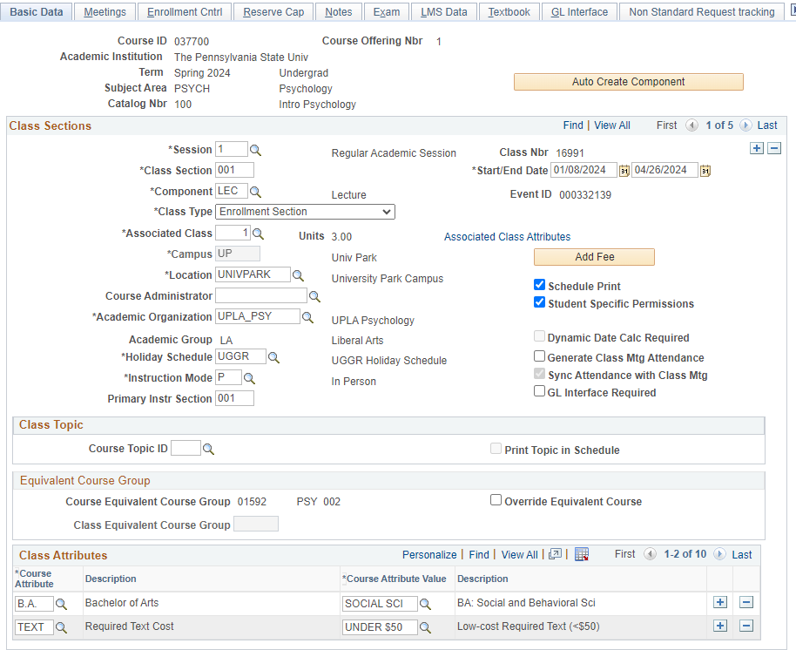
How are courses marked?

Slide 30
How do students find courses?
Students search by the main course attribute and then they can search for an attribute value in the same way they can search for courses that have the General Education attribute and one of the associated Gen Ed values [e.g., Social & Beh Sci (GS)].
If a student clicks on a course section marked with one of the “Required Text Cost” designations, they will then see a longer description of attribute’s value in the Enrollment Information field.
For no-cost sections, the long description reads: “This section’s required text cost is $0”
For low-cost sections, the long description reads: “This sections’ required text cost is under $50.”

Slide 31
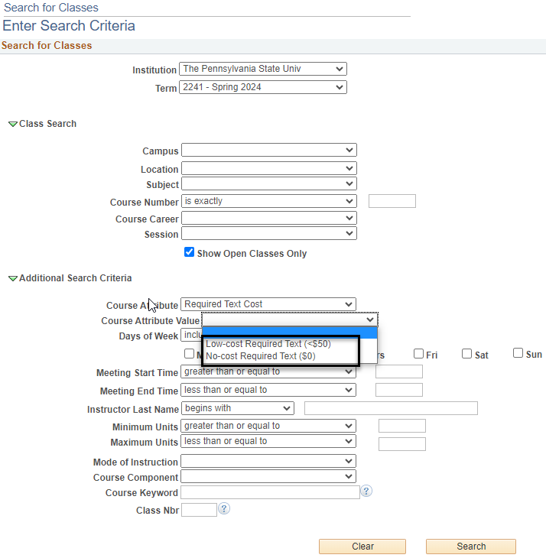
How do students find courses?

Slide 32
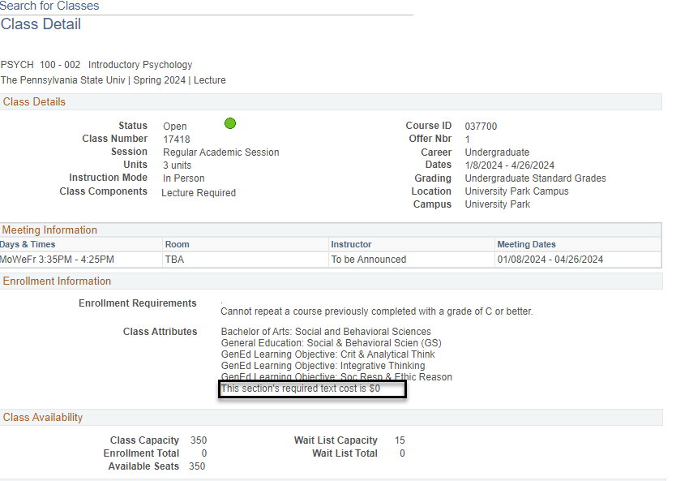
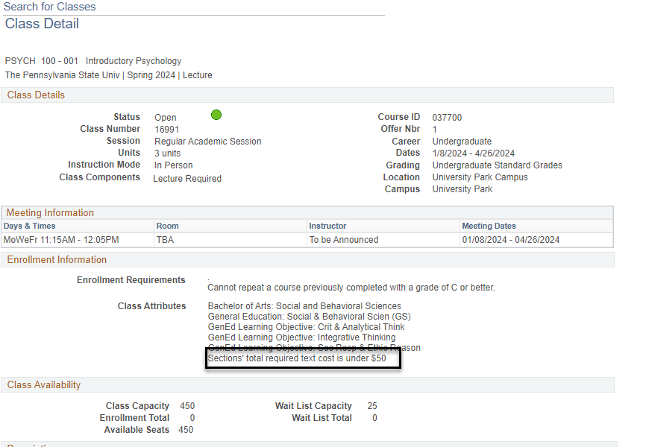
How do students find courses?

Slide 33
Timing
Both attributes are currently in LionPATH and can be used by anyone
Some campuses and departments have volunteered to be part of the pilot program that begins with the Spring 2024 semester. However, anyone can use them that isn’t part of the pilot program
The goal is for these attributes to be added prior to the beginning of registration for Spring 2024, which begins on October 4th
These attributes will roll when we roll Spring 2024 to Spring 2025 in April of 2024. Campus registrars and academic schedulers will need to clean these up each semester after the roll.

Slide 34
Resources
LionPATH query PE_SR_CLASS_ATTRIBUTE will allow you to find any classes with this designation
Website with more information about this initiative:
https://sites.psu.edu/coursemarkings/

Slide 35
Room Characteristics

Slide 36
Room Characteristics
Room characteristics can be added to classes in LionPATH on the Meetings tab in Maintain Schedule of Classes
Only add characteristics needed or requested by the instructor
With new buildings being built and rooms being updated regularly, you need to check the room features and capacity in 25Live to make sure you are still requesting the correct information
The Optimizer will only find you rooms with the capacity and room characteristics you requested. If a room doesn’t exist with the combination of room characteristics and capacity you requested, you will not get a room.

Slide 37
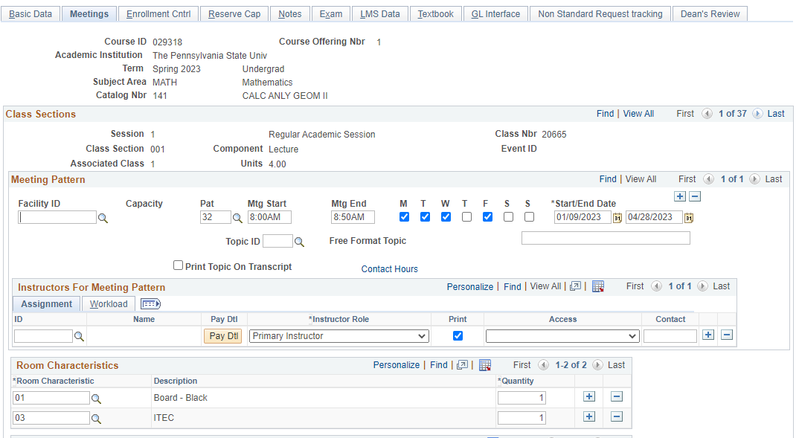
Room Characteristics

Slide 38
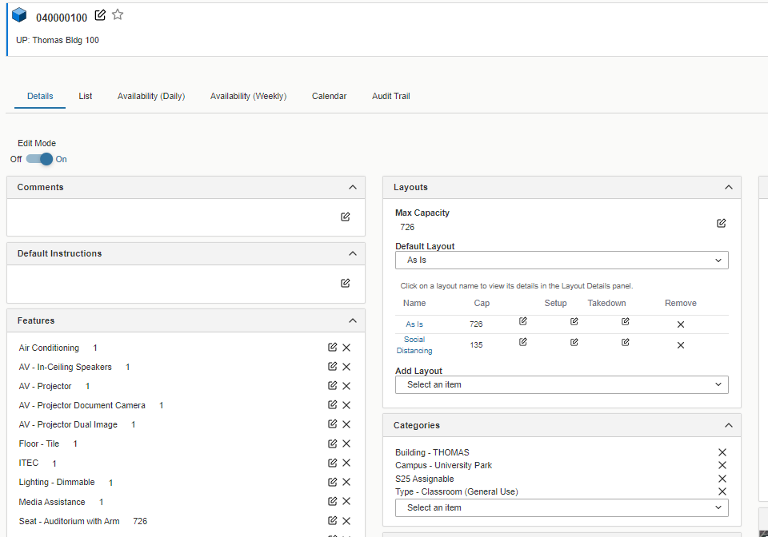
Room Characteristics

Slide 39
Resources
LionPATH query
PE_SR_ROOM_CHARACTERISTICS will allow you to see any classes for a specific term, campus, and subject that have requested room characteristics

Slide 40
One Semester Title Classes

Slide 41
One Semester Title Classes
Now only one form for one-semester titles, Faculty Senate Approved Option (FSOP) and GenEd requests
https://senate.psu.edu/curriculum/one-semester-titles-request-form/
If you are offering a x97 class with a GenEd, you must wait for Faculty Senate approval before adding the attributes to the class
Do not add GenEd attributes until you receive approval
You will receive an email when it has been approved

Slide 42
Distribution of Classes and Room Requests

Slide 43
Spring 2024 Distribution of Classes

Slide 44
Size Requests for Spring 2024
Room Size Ranges | Number of Rooms | Max Number of Classes | Number of Requests
314-736 | 8 | 120 | 133
150-261 | 16 | 240 | 290
80-149 | 33 | 495 | 438
51-79 | 38 | 570 | 710
45-50 | 52 | 780 | 927
30-44 | 127 | 1905 | 1628
12-29 | 99 | 1485 | 2927
Total | 373 | 5595 | 7053
If we only look at standard time with MWF 50-minute classes and TR 75-minute classes, a classroom can only accommodate 15 classes between 8:00am and 6:00pm.

Slide 45
Time Requests for Spring 2024
Meeting Pattern | UGRD | GRAD | Total
TR 10:35 am - 11:50 am | 388 | 55 | 443
TR 9:05 am - 10:20 am | 370 | 50 | 420
TR 1:35 pm - 2:50 pm | 353 | 55 | 408
TR 12:05 pm - 1:20 pm | 352 | 38 | 390
MWF 10:10 am - 11:00 am | 355 | 14 | 369
TR 3:05 pm - 4:20 pm | 292 | 25 | 317
MWF 11:15 am - 12:05 pm | 286 | 17 | 303
As a reminder, we only have 373 general-purpose classrooms.

Slide 46
Number of Requests by Class Start Time for Spring 2024

Slide 47
Room Type Requests for Spring 2024
Room Type | Number of Rooms | Number of Requests
ITEC | 335 | 3817
STEC | 38 | 474
When requesting a STEC room, please add the number of computers you need for the class.
The capacity of some STEC rooms and the number of computers don’t match

Slide 48
Scheduling Issues
Departments not pre-assigning their department labs or department classrooms prior to the Optimizer run.
Classes asking for too many or conflicting room characteristics
Cross-listed classes not combined prior to the Optimizer
Hybrid classes not cleaned up-Zoom or Web facility ID missing from the online meeting pattern
Nonstandard classes-288 for Spring 2024
Lack of classes being spread out across the day and week
Lack of classrooms with seating capacity of 150 and more
SP23 classes requesting a room with capacity of 150 and above=300
SP24 classes requesting a room with capacity of 150 and above=341
Continuing loss of general-purpose classrooms (GPCs)
Spring 2017 we had 412 rooms
Spring/Fall 2023 we have 373 rooms
Rooms will continue to decrease with upcoming capital plans

Slide 49
Best Practices

Slide 50
Best Practices
Only make room changes in 25Live
Any other changes for a class should be done only in LionPATH
Make sure you wait until you see change in 25Live before you search for a room
Make sure your requested room capacity in LionPATH is always less than or equal to the capacity of the room you have in 25Live. We’ve seen rooms drop when the requested room capacity is higher than the capacity of your assigned room.
If you change the time or days of your class, your room will most likely be dropped. Make sure to check for a room after you make a change.

Slide 51
Random Reminders

Slide 52
Random Reminders
No food in GPCs
You cannot schedule events in GPCs until a semester is published
Spring 2024 events can be scheduled after September 5th
Summer 2024 events can be scheduled after November 13th
Fall 2024 events can be scheduled after February 1st
Spring 2024 Optimizer results will be available on July 26th
We rolled Summer 2023 to Summer 2024 on July 10th
We will remove your access on September 8th to run Optimizer
We will release Optimizer results on September 18th
We will roll Fall 2023 to Fall 2024 on September 5th
We will remove your access on November 3rd to run Optimizer
We will release Optimizer results on December 8th

Slide 53
Discussion & Questions
https://www.registrar.psu.edu/faculty-staff/scheduling/index.cfm

